Slide 1
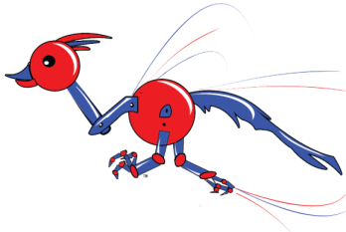
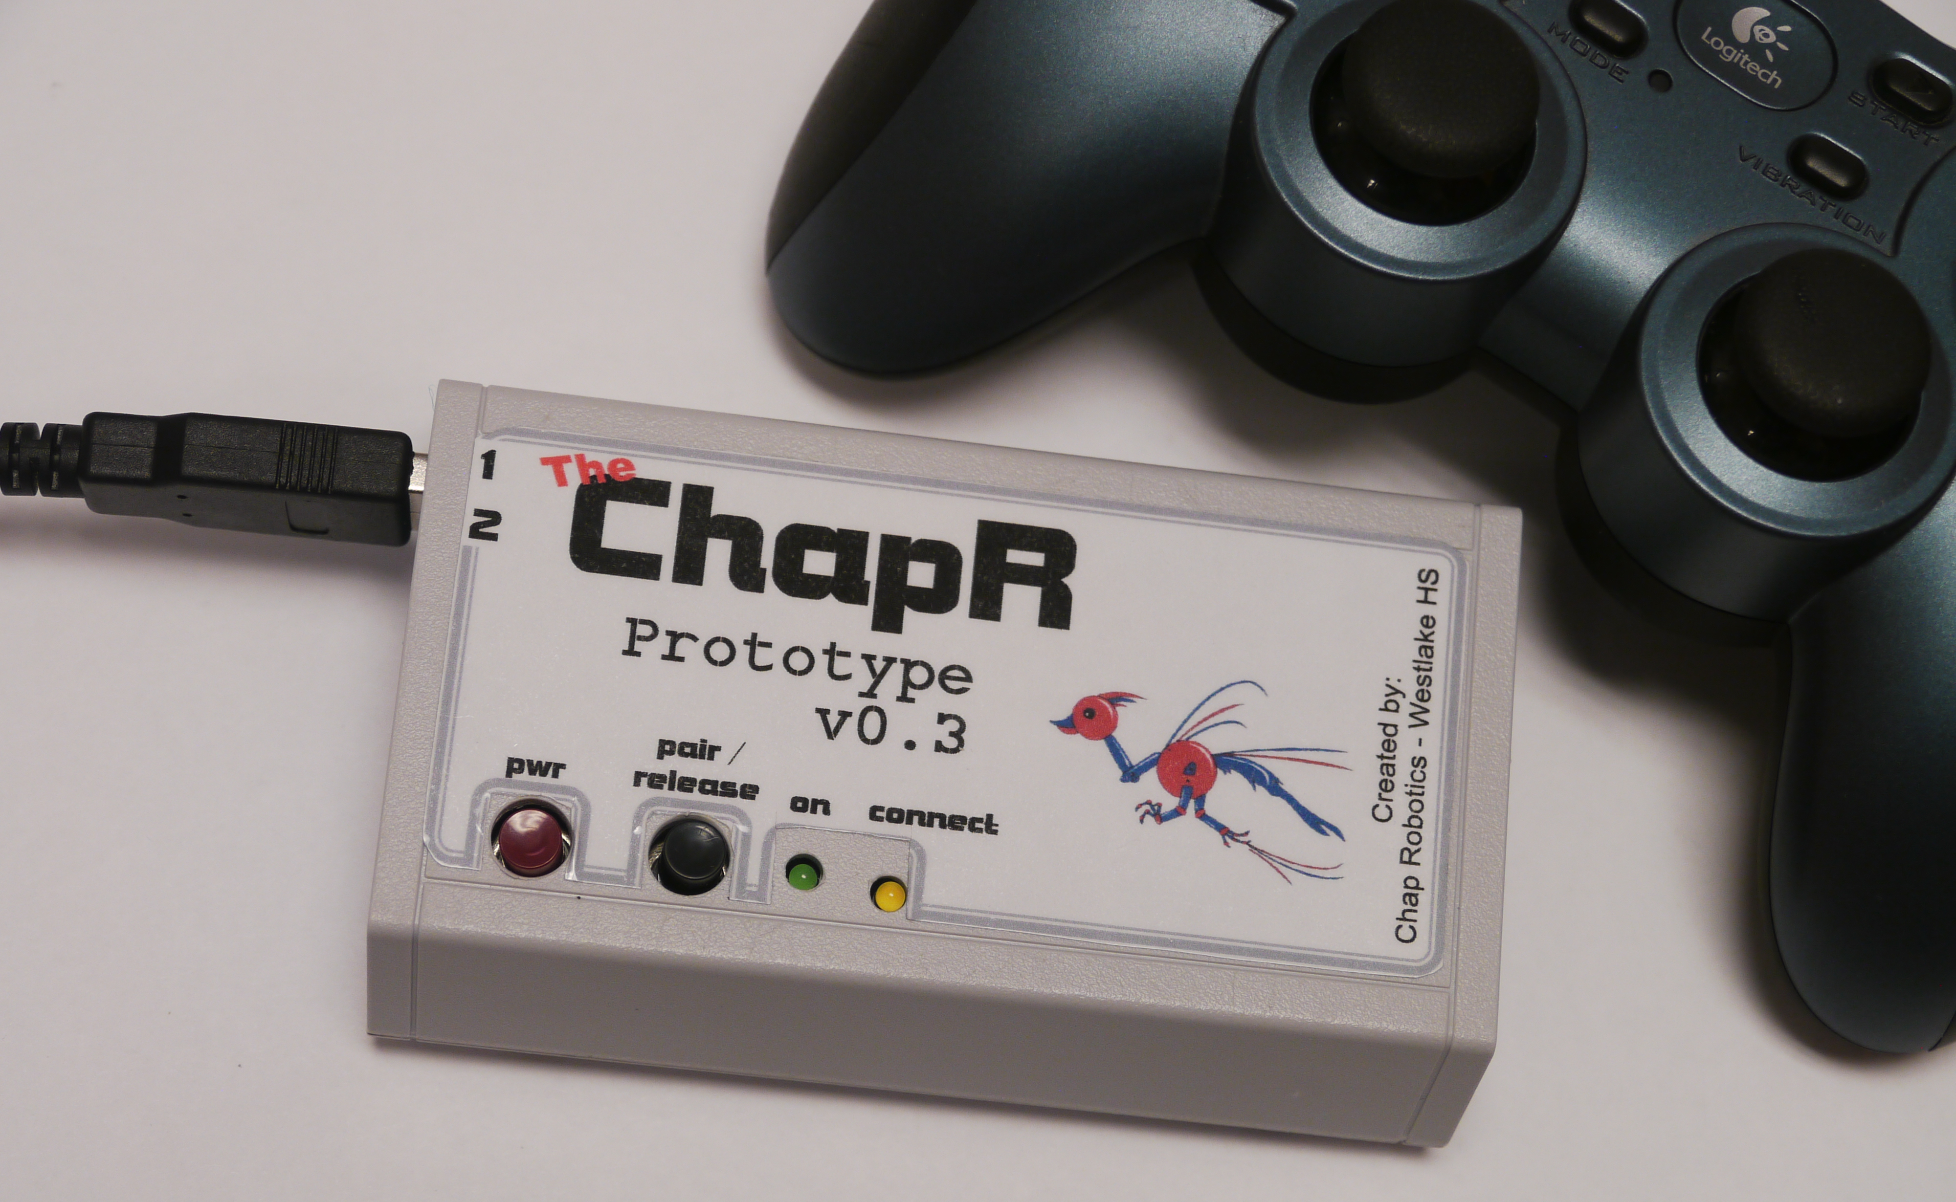
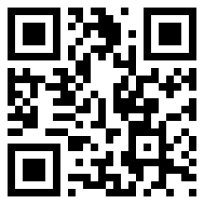
Outreach
ChapR
Fundraising/Donations
We make a 25% profit on each ChapR, and we use those profits to fund ChapRs for less fortunate teams. Donations are encouraged; we love helping out teams in need. If you’re a team who doesn’t think a ChapR is the best decision for their budget, let us know and we can try to get you one for free.
General Info
The ChapR allows for drive practice without a PC, allowing for increased convenience.
About Chap Robotics
Chap Robotics now has 4 FTC teams and 1 FRC team. It is associated with Westlake High School.
Features include:
Bluetooth connection to NXT brick (no computer needed!)
2 joysticks can be plugged in for driving
Button release of waitForStart() in selected program
Compatible with RobotC, LabView and NXT-G
Come check us out at:
www.thechapr.com/

Slide 2
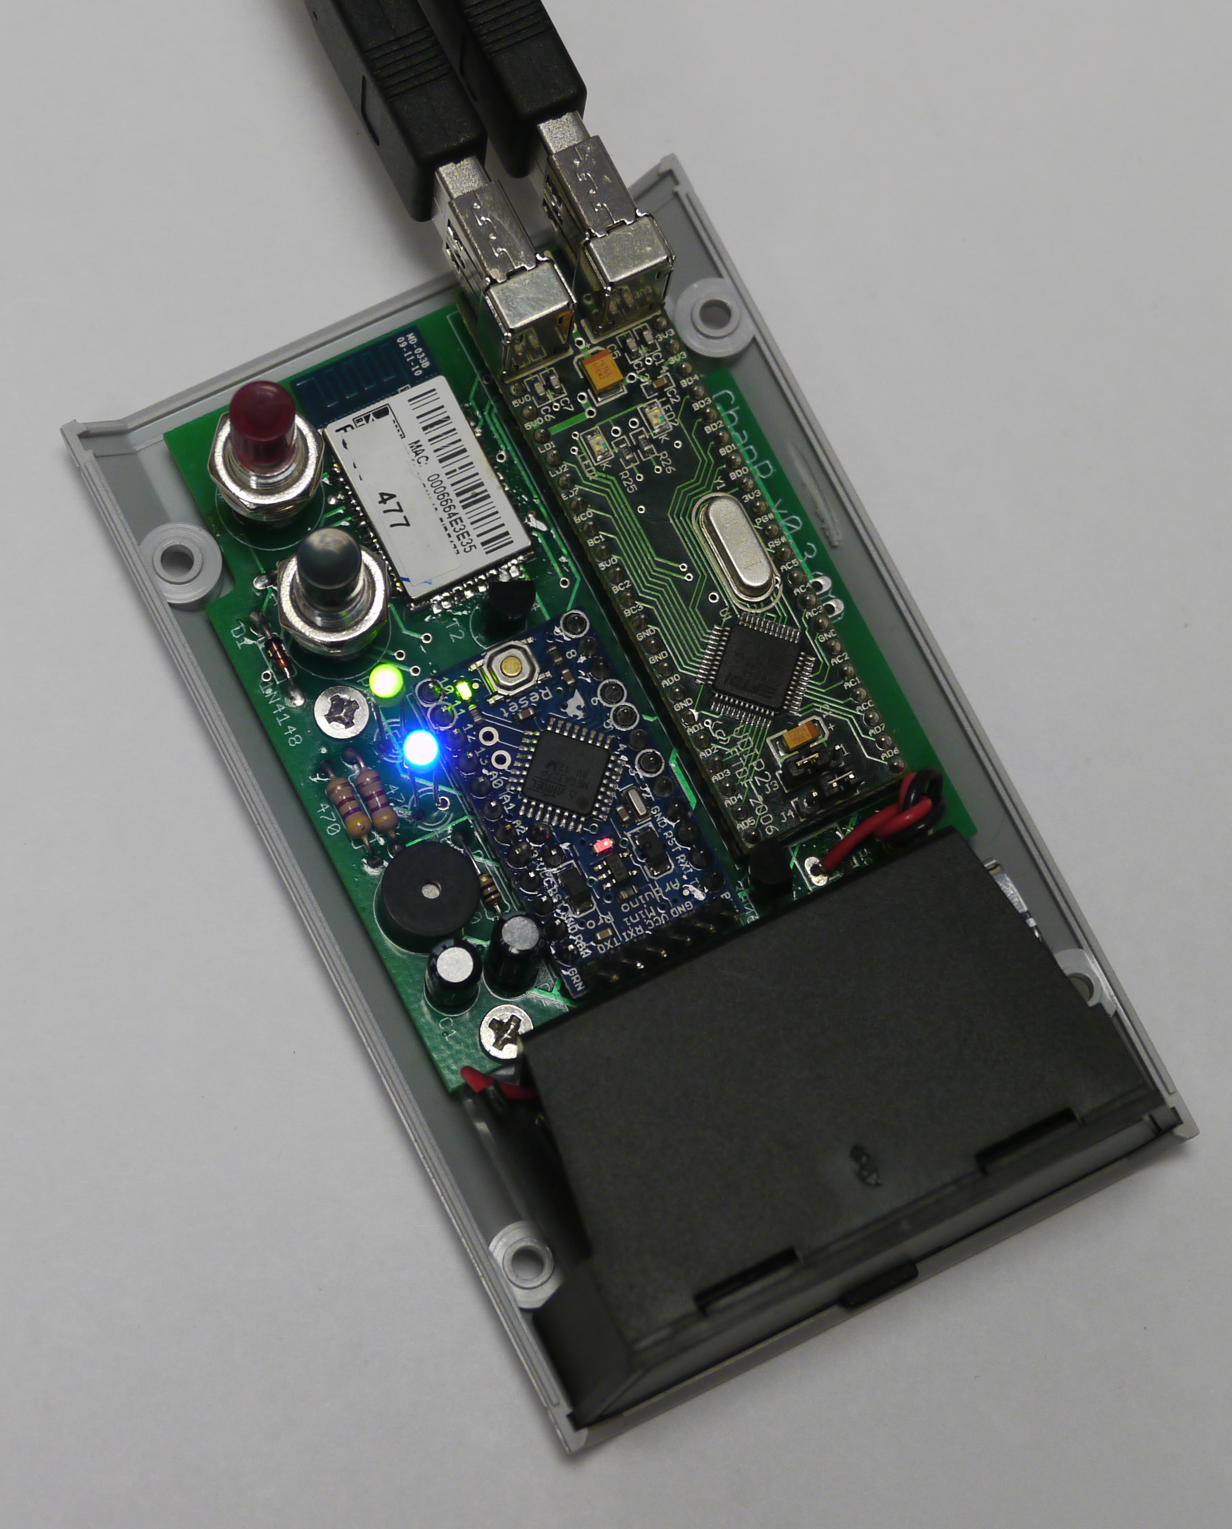
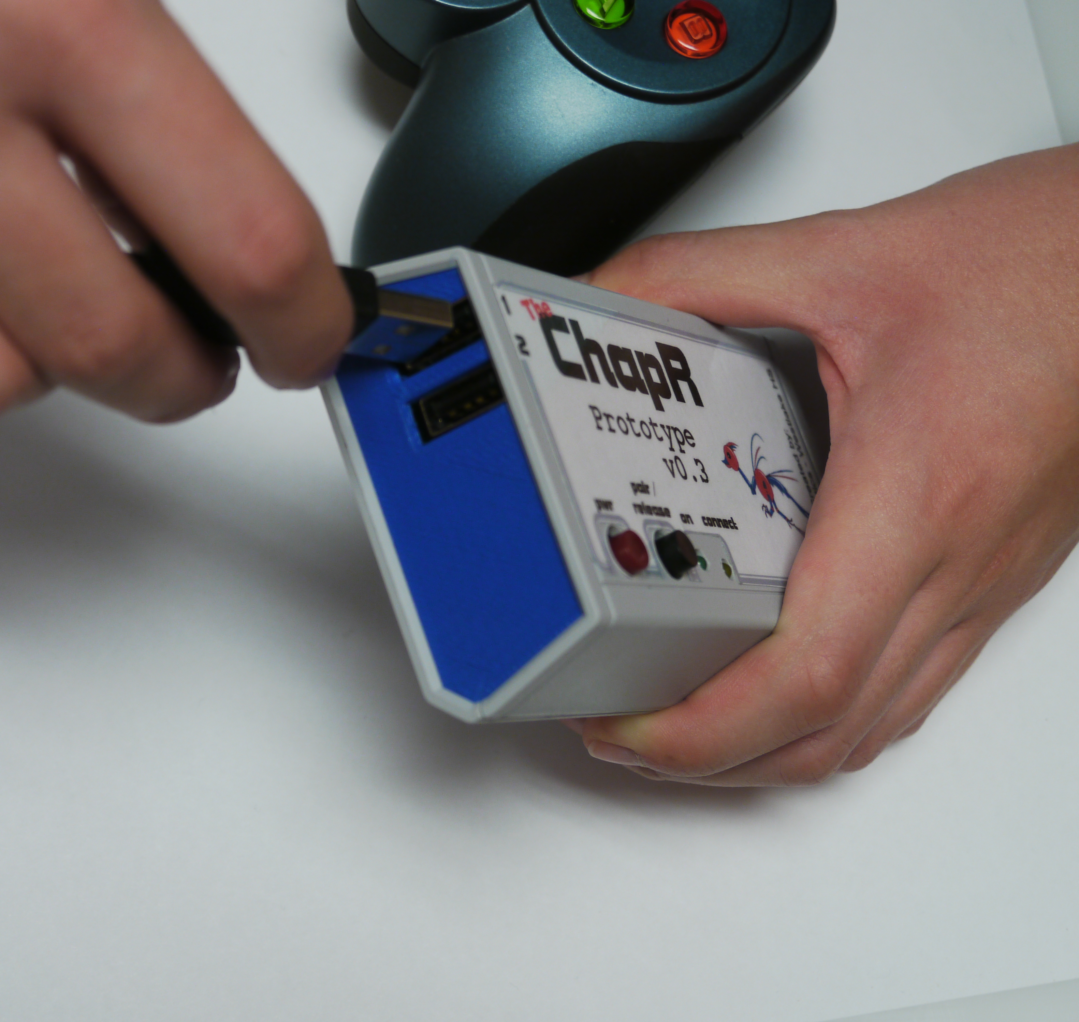
Hardware
Software
Highlights:
Runs on a 9V battery for 8 hours of continuous use
Pocket-size!
Can connect via USB when needed
Highlights:
Turns off when not in use
Customizable settings!
Programmable (with a special cable)
Internal Design Custom-made board:
VDIP (2 USB ports to receive joystick input)
LEDs (one green and one blue)
Speaker (to transmit information to user)
WFS Button (to make the ChapR bluetooth discoverable or release a waitForStart)
Power Button (to turn on the ChapR and keep it from powering off in your pocket)
Bluetooth module (which sends joystick input to the NXT)
Overall Layout After the joysticks are plugged in, the ChapR pulls the joystick readings from the USB ports and formats them into something the NXT can understand and use while running its program. Then those signals are sent out over Bluetooth to the NXT based on the “personality” the ChapR is set to (RobotC, LabView or NXT-G)
See www.thechapr.com/ for more info!

